Slide 1
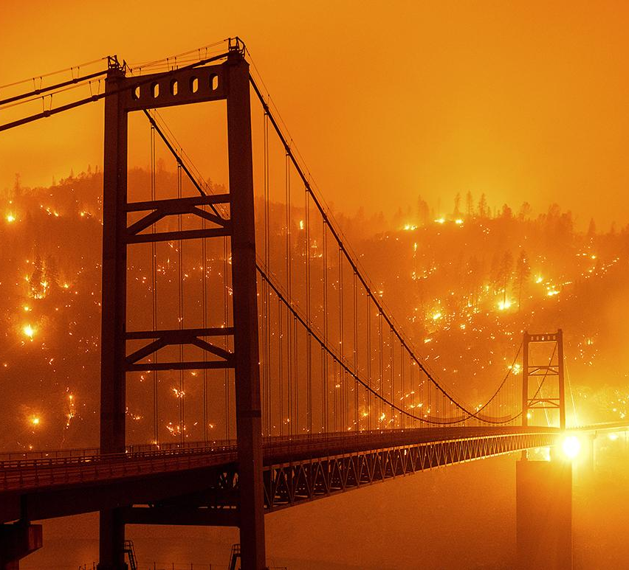
INFERNO PREDICTOR
FIRE PREDICTION SYSTEM FOR YOUR SAFETY
Project Advisor: Ahmed Banafa
Group Number: 12
Members:
Deep Patel
Jay Solanki
Nimay Patel
Soumya Trivedi

Slide 2
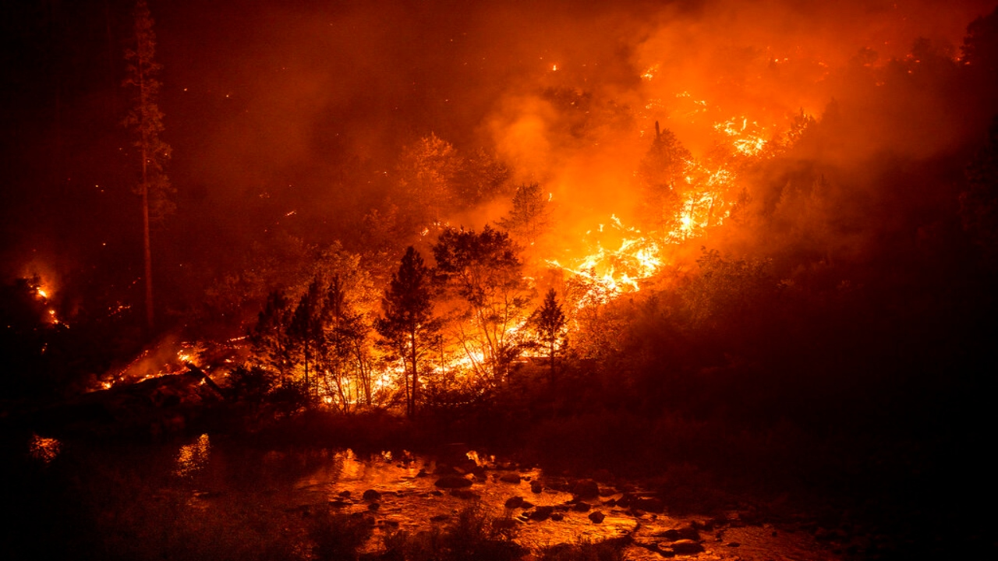
DESCRIPTION
Inferno Alert is a system which predicts wildfires beforehand
Existing fire alert applications don't alert people until the fire is ablaze
The project takes into consideration environmental factors such as wind, temperature and historical data into consideration.

Slide 3

TEAM MEMBERS ROLE
Jay: User Interface Development
Nimay: Dataset Management and Software Testing.
Soumya: API Development using Flask
Deep: Machine Learning Algorithm Development
For individual responsibility management, we use a software called Jira.

Slide 4
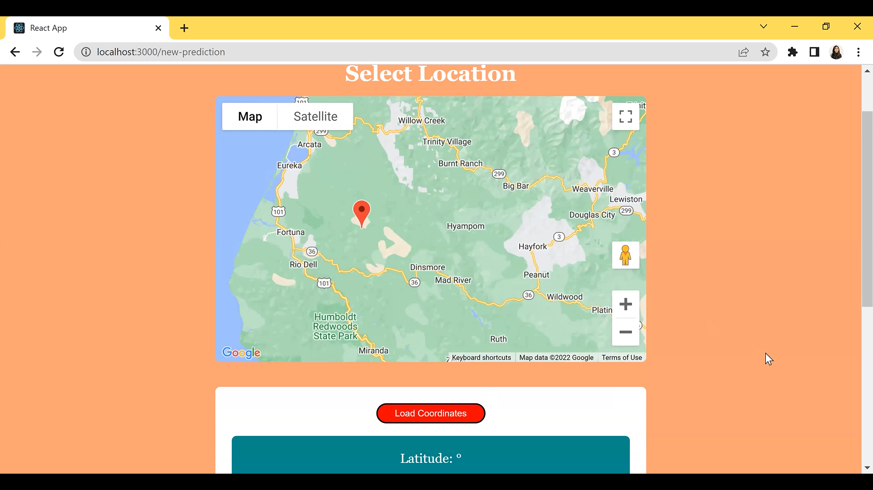
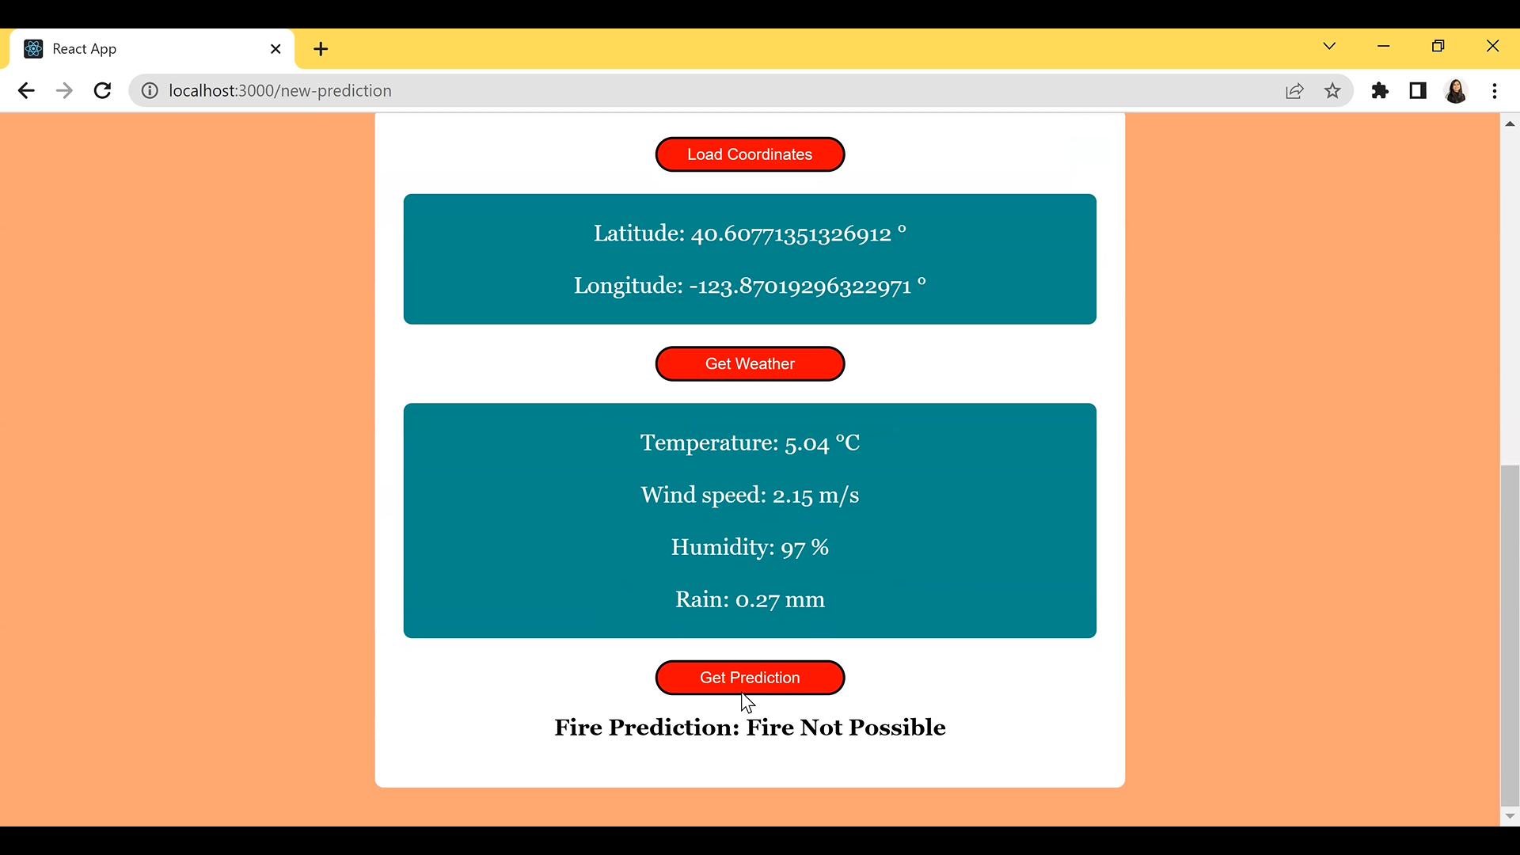
System Demonstration Sample 1:

Slide 5
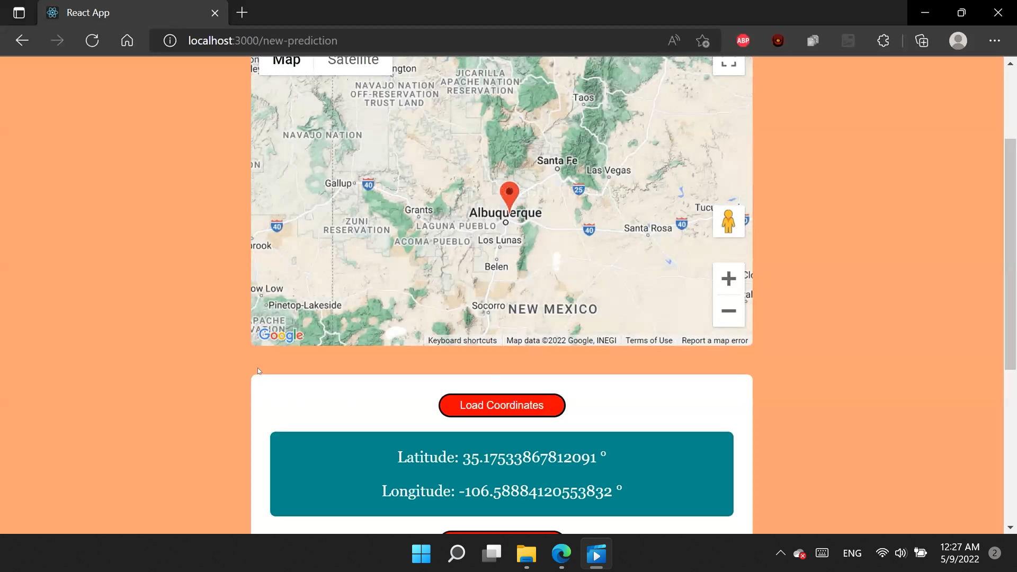
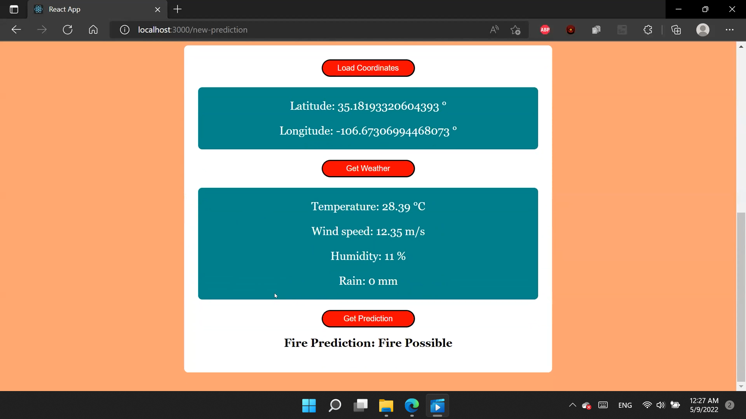
System Demonstration Sample 2:

Slide 6
Conclusion:
Our application lets all customers select any location and make a prediction on whether the risk of fire is there or not using the current weather conditions in the location.
This web application does not store or sell any user device information for any 3rd party vendors and comes with cross browser compatibility.
In a distant future, we believe that there is room for analyzing historic weather data and proactively creating wildfire prediction data clusters over a period of years and determine which locations are not suitable for human inhabitation.

Slide 7
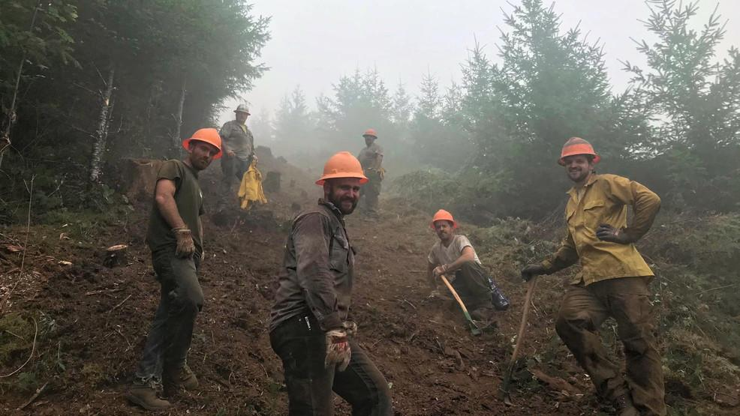
THANK YOU!!!

